Slide 1
Wells Fargo Technology Hackathon 2022 Name Pronunciation Tool
Team Zion
May 2022

Slide 2




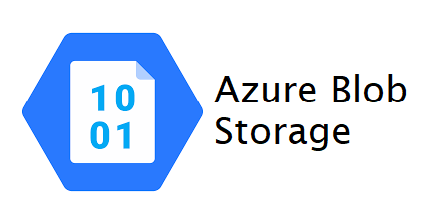


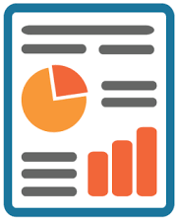
High Level Flow – Name Pronunciation Tool
API
Data Storage
Wells Fargo employees and contingent workers can hear and practice custom pronunciation
Wells Fargo employees and contingent workers entering custom pronunciation
Machine Learning Algorithm
Simple reporting like how many people used this name pronunciation too.

Slide 3
Technology Stack – Name Pronunciation Tool
Microsoft .NET
Azure SQL
Azure Blog Storage
Java Script
Python Flask
OpenCV
API
GTTS
OKTA

Slide 4
Thank You

